Slide 1


پروژه مدار های الکتریکی (1) نام استاد : دکتر افضلیان
اعضای گروه : علیرضا منتجب ، عرفان فقهی ، علی وثوق نیا ، ارغوان معماری

Slide 2
فهرست
شماتیک
پاسخ ورودی صفر
فرکانس های طبیعی
پاسخ پله
پاسخ ضربه
معادلات حالت
حالت دایمی سینوسی
امپدانس و ادمیتانس دیده شده از دو سر منبع
توان و بازدهی

Slide 3
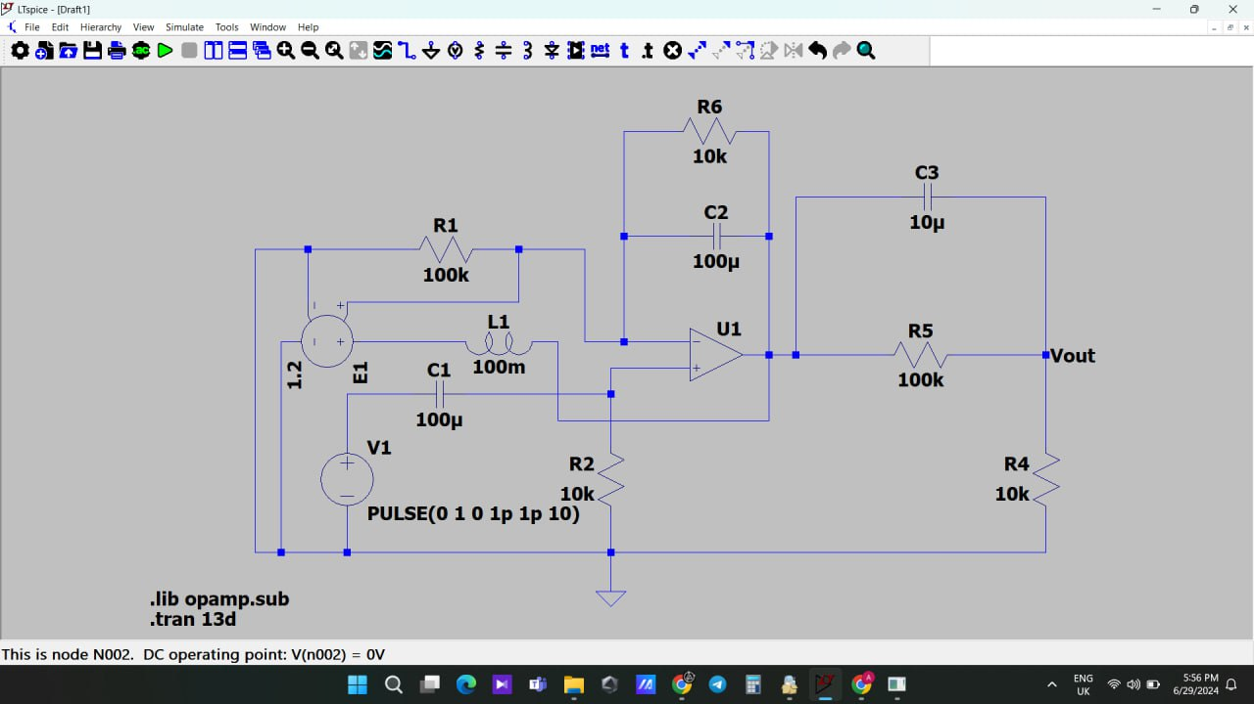
شماتیک مدار

Slide 4
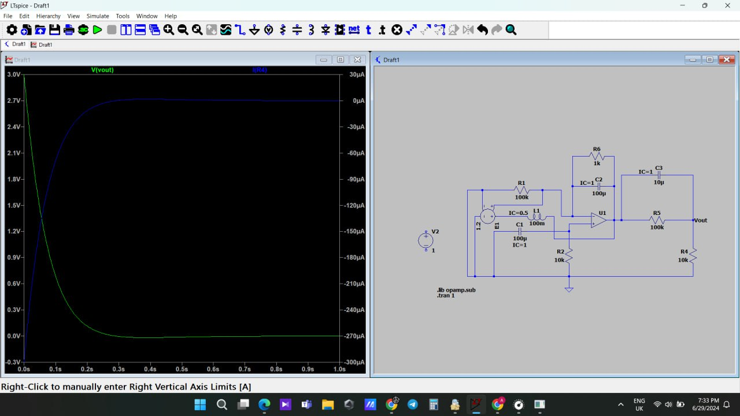
پاسخ ورودی صفر

Slide 5

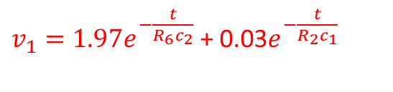




$v_{1}\left(0\right)= v_{c_{1}}$(0) = $v_{c_{2}}$(0) = $1v$
$c_{1}\frac{dv_{+}}{dt}$ + $\frac{v_{+}}{R_{2}}$ = 0
$v_{+}$ = k $e^{−\frac{t}{R_{2}c_{1}}}$
K= $v_{c_{1}}$(0)
$v_{+}$ = $e^{−\frac{t}{R_{2}c_{1}}}$
$v_{+}$
$\frac{v_{−}}{R_{1}}$ + $\frac{{v_{− }}_{−} v_{1}}{R_{6}}$ + $c_{2}\frac{d{v_{− }}_{−} v_{1}}{dt}$ = 0
($\frac{v_{c_{1}}(0) }{c_{2}R_{1}}$ + $\frac{v_{c_{1}}(0) }{c_{2}R_{1}}$ + $\frac{v_{c_{1}}(0) }{c_{1}R_{2}}$)$e^{−\frac{t}{R_{2}c_{1}}}$ = $\frac{dv_{1}}{dt}$ + $\frac{v_{1}}{\begin{aligned}c_{2}R_{6} \\ \end{aligned}}$
$v_{1}= k_{1}e^{−\frac{t}{R_{6}c_{2}}}$ + A$e^{−\frac{t}{R_{2}c_{1}}}$
A = $\frac{(\frac{v_{c_{1}}(0) }{c_{2}R_{1}} + \frac{v_{c_{1}}(0) }{c_{2}R_{1}} + \frac{v_{c_{1}}(0) }{c_{1}R_{2}}) }{\frac{1}{c_{2}R_{6}}− \frac{1}{c_{1}R_{2}}}$ = 0.03
$v_{1}\left(0\right)= v_{c_{1}}$(0) + $v_{c_{2}}$(0) = $k_{1}+A$
$k_{1}= v_{c_{1}}$(0) + $v_{c_{2}}$(0) – A = 1.97
$v_{−}$
$v_{1}=1.97e^{−\frac{t}{R_{6}c_{2}}}$ + 0.03$e^{−\frac{t}{R_{2}c_{1}}}$

Slide 6

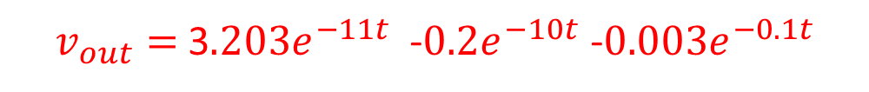
$\frac{v_{out}− v_{1}}{R_{5}}$ + $c_{3}\frac{dv_{out}− v_{1}}{dt}$ + $\frac{v_{out}}{R_{4}}$ = 0
$\frac{v_{out}}{{c_{3}R}_{5}}$ + $\frac{dv_{out}}{dt}$ + $\frac{v_{out}}{R_{4}c_{3}}$= $\frac{v_{1}}{{c_{3}R}_{5}}$ + $\frac{dv_{1}}{dt}$
$v_{out}=$B$e^{−\frac{t({c_{3}R}_{5}+ R_{4}c_{2} )}{{c_{3}R}_{5}R_{4}c_{3}}}$ + C$e^{−\frac{t}{R_{6}c_{2}}}$ + D$e^{−\frac{t}{R_{2}c_{1}}}$
$v_{out}$(0) = $v_{c_{1}}$(0) + $v_{c_{2}}$(0) + $v_{c_{3}}$(0) =3= B+C+D
$e^{−\frac{t}{R_{6}c_{2}}}(\frac{k_{1}}{{c_{3}R}_{5}}+ \frac{−k_{1}}{c_{2}R_{6}})$ + $e^{−\frac{t}{R_{2}c_{1}}}$($\frac{A}{{c_{3}R}_{5}}+ \frac{−A}{c_{1}R_{2}}$) = $\frac{v_{out}}{{c_{3}R}_{5}}$ + $\frac{dv_{out}}{dt}$ + $\frac{v_{out}}{R_{4}c_{3}}$
$e^{−\frac{t}{R_{6}c_{2}}}(\frac{k_{1}}{{c_{3}R}_{5}}+ \frac{−k_{1}}{c_{2}R_{6}})$ + $e^{−\frac{t}{R_{2}c_{1}}}$($\frac{A}{{c_{3}R}_{5}}+ \frac{−A}{c_{1}R_{2}}$) = $\frac{Ce^{−\frac{t}{R_{6}c_{2}}} + De^{−\frac{t}{R_{2}c_{1}}}}{{c_{3}R}_{5}}$ + $\frac{−C}{c_{2}R_{6}}e^{−\frac{t}{R_{6}c_{2}}}+ \frac{−D}{c_{1}R_{2}}e^{−\frac{t}{R_{2}c_{1}}}+ \frac{ Ce^{−\frac{t}{R_{6}c_{2}}} + De^{−\frac{t}{R_{2}c_{1}}}}{{c_{3}R}_{4}}$
C=$\frac{ \frac{k_{1}}{{c_{3}R}_{5}}+ \frac{−k_{1}}{c_{2}R_{6}}}{\frac{−1}{c_{2}R_{6}}+\frac{1}{{c_{3}R}_{5}}+\frac{1}{{c_{3}R}_{4}}}$ = -0.2 D=$\frac{\frac{A}{{c_{3}R}_{5}}+ \frac{−A}{c_{1}R_{2}}}{\frac{−1}{c_{1}R_{2}}+\frac{1}{{c_{3}R}_{5}}+\frac{1}{{c_{3}R}_{4}}}$=-0.003 B=3.203
$v_{out}=$3$.203e^{−11t}$ -$0.2e^{−10t}$ -$0.003e^{−0.1t}$

Slide 7


Slide 8
پاسخ ورودی پلّه

Slide 9

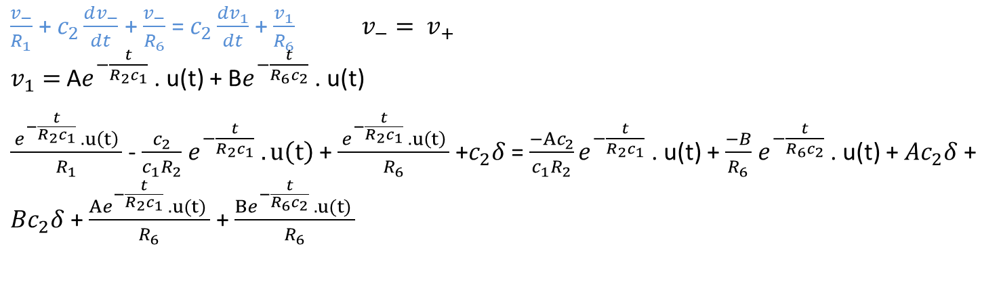


1R1 - c2c1R2 + 1R6 = -Ac2c1R2 + AR6
A= 1.01
c2 = Ac2 + Bc2 B=-0.01
v1= 1.01e-tR2c1 . u(t) - 0.01e-tR6c2 . u(t)
$c_{1}\frac{dv_{+}}{dt}$ + $\frac{v_{+}}{R_{2}}$ = $c_{1}\frac{dv_{in}}{dt}$
$v_{+}$= k$e^{−\frac{t}{R_{2}c_{1}}}$ . u(t)
$\frac{−k}{R_{2}}e^{−\frac{t}{R_{2}c_{1}}}$ + k$c_{1}δ$ + $\frac{ke^{−\frac{t}{R_{2}c_{1}}} . u(t) }{R_{2}}$ = $c_{1}δ$
k=1
$v_{+}$= $e^{−\frac{t}{R_{2}c_{1}}}$ . u(t)
$v_{+}$
$\frac{v_{−}}{R_{1}}$ + $c_{2}\frac{dv_{−}}{dt}$ + $\frac{v_{−}}{R_{6}}$ = $c_{2}\frac{dv_{1}}{dt}$ + $\frac{v_{1}}{R_{6}} v_{−}= v_{+}$
$v_{1}=$A$e^{−\frac{t}{R_{2}c_{1}}}$ . u(t) + B$e^{−\frac{t}{R_{6}c_{2}}}$ . u(t)
$\frac{ e^{−\frac{t}{R_{2}c_{1}}} . u\left(t\right) }{R_{1}}$ - $\frac{c_{2}}{c_{1}R_{2}}$ $e^{−\frac{t}{R_{2}c_{1}}} . u\left(t\right)$ + $\frac{ e^{−\frac{t}{R_{2}c_{1}}} . u\left(t\right) }{R_{6}}$ +$c_{2}δ$ = $\frac{−Ac_{2}}{c_{1}R_{2}}e^{−\frac{t}{R_{2}c_{1}}}$ . u(t) + $\frac{−B}{R_{6}}$ $e^{−\frac{t}{R_{6}c_{2}}}$ . u(t) + ${Ac}_{2}δ$ + ${Bc}_{2}δ$ + $\frac{Ae^{−\frac{t}{R_{2}c_{1}}} . u(t) }{R_{6}}$ + $\frac{Be^{−\frac{t}{R_{6}c_{2}}} . u(t) }{R_{6}}$
$v_{−}$

Slide 10

$\frac{v_{out}− v_{1}}{R_{5}}$ + $c_{3}\frac{dv_{out}− v_{1}}{dt}$ + $\frac{v_{out}}{R_{4}}$ = 0
$\frac{v_{out}}{{c_{3}R}_{5}}$ + $\frac{dv_{out}}{dt}$ + $\frac{v_{out}}{R_{4}c_{3}}$= $\frac{v_{1}}{{c_{3}R}_{5}}$ + $\frac{dv_{1}}{dt}$
$v_{out}=$B$e^{−\frac{t({c_{3}R}_{5}+ R_{4}c_{2} )}{{c_{3}R}_{5}R_{4}c_{3}}}$ .u(t)+ C$e^{−\frac{t}{R_{6}c_{2}}}$ .u(t)+ D$e^{−\frac{t}{R_{2}c_{1}}}$.u(t)
$\frac{Be^{−\frac{t({c_{3}R}_{5}+ R_{4}c_{2} )}{{c_{3}R}_{5}R_{4}c_{3}}} .u(t)+ Ce^{−\frac{t}{R_{6}c_{2}}} .u(t)+ De^{−\frac{t}{R_{2}c_{1}}}.u(t)}{{c_{3}R}_{5}}$ جمله اول
$\frac{dv_{out}}{dt}$ = $−\frac{t({c_{3}R}_{5}+ R_{4}c_{2} )}{{c_{3}R}_{5}R_{4}c_{3}}$ B$e^{−\frac{t({c_{3}R}_{5}+ R_{4}c_{2} )}{{c_{3}R}_{5}R_{4}c_{3}}}$.u(t) + B$. δ$ $−\frac{t}{R_{6}c_{2}} Ce^{−\frac{t}{R_{6}c_{2}}} .u(t)$ + $C. δ$ $−\frac{t}{R_{2}c_{1}} De^{−\frac{t}{R_{2}c_{1}}}.u(t)$ + $D. δ$
(جمله دوم)
$\frac{Be^{−\frac{t({c_{3}R}_{5}+ R_{4}c_{2} )}{{c_{3}R}_{5}R_{4}c_{3}}} .u(t)+ Ce^{−\frac{t}{R_{6}c_{2}}} .u(t)+ De^{−\frac{t}{R_{2}c_{1}}}.u(t)}{{c_{3}R}_{4}}$ $−\frac{t({c_{3}R}_{5}+ R_{4}c_{2} )}{{c_{3}R}_{5}R_{4}c_{3}}$ B$e^{−\frac{t({c_{3}R}_{5}+ R_{4}c_{2} )}{{c_{3}R}_{5}R_{4}c_{3}}}$.u(t) + B$. δ−\frac{t}{R_{6}c_{2}} Ce^{−\frac{t}{R_{6}c_{2}}} .u(t)$ + $C. δ$ $−\frac{t}{R_{2}c_{1}} De^{−\frac{t}{R_{2}c_{1}}}.u(t)$ + $D. δ$ + $\frac{Be^{−\frac{t({c_{3}R}_{5}+ R_{4}c_{2} )}{{c_{3}R}_{5}R_{4}c_{3}}} .u(t)+ Ce^{−\frac{t}{R_{6}c_{2}}} .u(t)+ De^{−\frac{t}{R_{2}c_{1}}}.u(t)}{{c_{3}R}_{5}}$ = $\frac{1.01e^{−\frac{t}{R_{2}c_{1}}} . u(t) − 0.01e^{−\frac{t}{R_{6}c_{2}}} . u(t)}{{c_{3}R}_{5}} −\frac{1.01}{R_{2}c_{1}}e^{−\frac{t}{R_{2}c_{1}}} . u(t)$ + $1.01 δ$ + $\frac{0.01}{R_{6}c_{2}}e^{−\frac{t}{R_{6}c_{2}}} . u(t)$ -0.01$δ$
$\frac{C}{{c_{3}R}_{4}}$ - $\frac{C}{{c_{2}R}_{6}}$ $+\frac{C}{{c_{3}R}_{5}}$ = $\frac{−0.01}{{c_{3}R}_{5}}+$ $\frac{0.01}{R_{6}c_{2}}$ c=0.0001
$\frac{D}{{c_{3}R}_{4}}$ - $\frac{D}{{c_{1}R}_{2}}$ $+\frac{D}{{c_{3}R}_{5}}$ = $\frac{1.01}{{c_{3}R}_{5}}−$ $\frac{1.01}{R_{6}c_{2}}$ B= -0.1
B + C + D =1 D =1.0999
$v_{out}= −0.1e^{−11t}$ .u(t)+ 0.0001$e^{−10t}$ .u(t)+ 1.0999$e^{−0.1t}$.u(t)

Slide 11
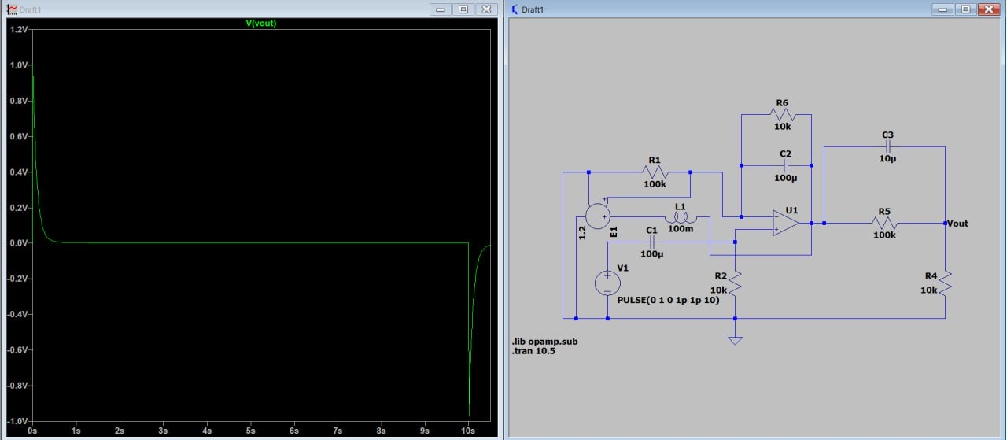

Slide 12
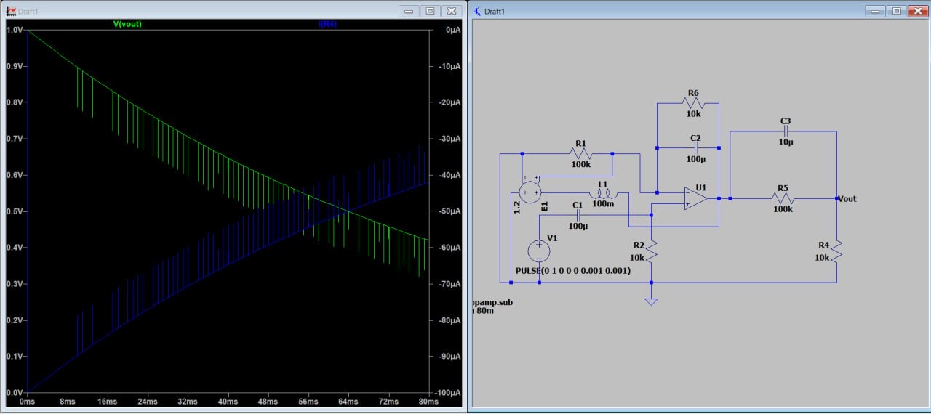
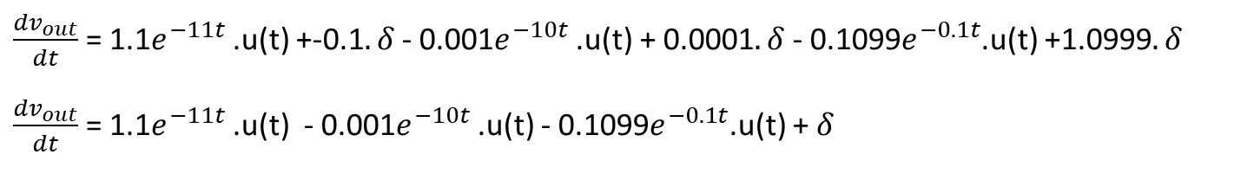
پاسخ ضربه
$\frac{dv_{out}}{dt}$ = 1.1$e^{−11t}$ .u(t) +-0.1$. δ$ - 0.001$e^{−10t}$ .u(t) + 0.0001$. δ$ - 0.1099$e^{−0.1t}$.u(t) +1.0999$. δ$
$\frac{dv_{out}}{dt}$ = 1.1$e^{−11t}$ .u(t) - 0.001$e^{−10t}$ .u(t) - 0.1099$e^{−0.1t}$.u(t) +$δ$

Slide 13
معادلات حالت

Slide 14



$$−v_{C_{1}}+v_{R_{2}}=0$$
$$v_{+}=v_{−}=v_{R_{2}}{=v}_{c_{1}}=R_{2} I_{c_{1}}=C_{1}R_{2}\frac{dv_{c_{1}}}{dt}$$
$$v_{C_{1}}=C_{1}R_{2}\frac{dv_{c_{1}}}{dt}$$
$$\frac{dv_{c_{1}}}{dt}=\frac{v_{C_{1}}}{C_{1}R_{2}}$$
$$I_{R_{1}}+I_{c_{2}}+I_{R_{6}}=0$$
$$\frac{v_{−}}{R_{1}}{+C}_{2}\frac{dv_{C_{2}}}{dt}+\frac{v_{c_{2}}}{R_{6}}=0$$
$$\frac{v_{c_{1}}}{R_{1}}{+C}_{2}\frac{dv_{C_{2}}}{dt}+\frac{v_{c_{2}}}{R_{6}}=0$$
$$\frac{dv_{C_{2}}}{dt}=−\frac{v_{c_{1}}}{R_{1}C_{2}}−\frac{v_{c_{2}}}{R_{6}C_{2}}$$
$v_{−}$

Slide 15


$$v_{L}+v_{E_{1}}−v_{R_{1}}+v_{R_{6}}=0$$
$$L\frac{di_{L}}{dt}+v_{c_{2}}+0.2v_{c_{1}}=0$$
$$\frac{di_{L}}{dt}=−\frac{v_{c_{2}}}{L}−\frac{0.2v_{c_{1}}}{L}$$
$$I_{R_{4}}+I_{c_{3}}+I_{R_{5}}=0$$
$$\frac{v_{out}}{R_{4}}+C_{3}\frac{ⅆv_{C_{3}}}{ⅆt}+\frac{v_{c_{3}}}{R_{5}}=0$$
$$v_{out}+v_{c_{3}}=v_{1}$$
$$v_{1}−v_{c_{2}}=v_{−}$$
$$v_{out}=v_{c_{2}}+v_{−}−v_{c_{3}}=v_{c_{2}}+v_{c_{1}}−v_{c_{3}}$$
$$\frac{ⅆv_{c_{3}}}{ⅆt}=−\frac{v_{out}}{R_{4}c_{3}}−\frac{v_{c_{3}}}{R_{5}c_{3}}$$
$$\frac{ⅆv_{c_{3}}}{ⅆt}=−\frac{v_{c_{1}}}{R_{4}c_{3}}−\frac{v_{c_{2}}}{R_{4}c_{3}}+(\frac{1}{R_{4}c_{3}}−\frac{1}{R_{5}c_{3}})v_{c_{3}}$$

Slide 16
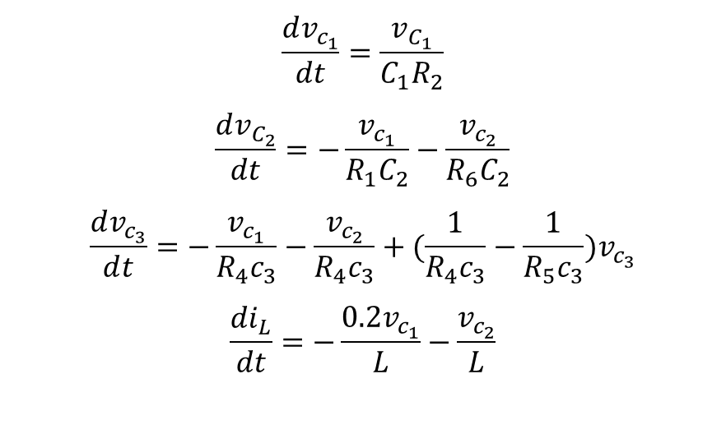

$$\frac{dv_{c_{1}}}{dt}=\frac{v_{C_{1}}}{C_{1}R_{2}}$$
$$\frac{dv_{C_{2}}}{dt}=−\frac{v_{c_{1}}}{R_{1}C_{2}}−\frac{v_{c_{2}}}{R_{6}C_{2}}$$
$$\frac{ⅆv_{c_{3}}}{ⅆt}=−\frac{v_{c_{1}}}{R_{4}c_{3}}−\frac{v_{c_{2}}}{R_{4}c_{3}}+(\frac{1}{R_{4}c_{3}}−\frac{1}{R_{5}c_{3}})v_{c_{3}}$$
$$\frac{di_{L}}{dt}=−\frac{0.2v_{c_{1}}}{L}−\frac{v_{c_{2}}}{L}$$
$$\left[\begin{aligned}\begin{matrix}\frac{dv_{c_{1}}}{dt} \\ \frac{dv_{C_{2}}}{dt} \\ \frac{ⅆv_{c_{3}}}{ⅆt}\end{matrix} \\ \frac{di_{L}}{dt}\end{aligned}\right]=\left[\begin{matrix}\frac{v_{C_{1}}}{C_{1}R_{2}} & 0 & 0 & 0 \\ −\frac{v_{c_{1}}}{R_{1}C_{2}} & −\frac{v_{c_{2}}}{R_{6}C_{2}} & 0 & 0 \\ −\frac{1}{R_{4}c_{3}} & −\frac{1}{R_{4}c_{3}} & (\frac{1}{R_{4}c_{3}}−\frac{1}{R_{5}c_{3}}) & 0 \\ −\frac{0.2v_{c_{1}}}{L} & −\frac{v_{c_{2}}}{L} & 0 & 0\end{matrix}\right]\left[\begin{aligned}v_{c_{1}} \\ v_{c_{2}} \\ v_{c_{3}} \\ i_{L}\end{aligned}\right]$$

Slide 17
حالت دایمی سینوسی

Slide 18




$\frac{v_{+}−E}{\frac{1}{jωc_{1}}}$ + $\frac{v_{+}}{R_{2}}$ = 0
$(jωc_{1}$ + $\frac{1}{R_{2}})v_{+}$=$jωC_{1}$E
$v_{+}$ = $\frac{jωC_{1}E}{(jωc_{1} + \frac{1}{R_{2}})}$
$v_{+}$
$\frac{v_{−}}{R_{1}}$ + $\frac{v_{−}− v_{1}}{R_{6}}$ + $\frac{v_{−}− v_{1}}{\frac{1}{jωc_{1}}}$ = 0
$v_{+}$($\frac{1}{R_{6}}$ + $\frac{1}{R_{1}}$ + $jωc_{2}$) = ( $\frac{1}{R_{6}}$+ $jωc_{2}$ )$v_{1}$
$v_{1}$ = $\frac{(\frac{1}{R_{6}} + \frac{1}{R_{1}} + jωc_{2}) }{( \frac{1}{R_{6}} + jωc_{2} )}$ $v_{+}$ = $\frac{(\frac{1}{R_{6}} + \frac{1}{R_{1}} + jωc_{2}) }{( \frac{1}{R_{6}} + jωc_{2} )}\frac{jωC_{1}E}{(jωc_{1} + \frac{1}{R_{2}})}$
$v_{−}$

Slide 19
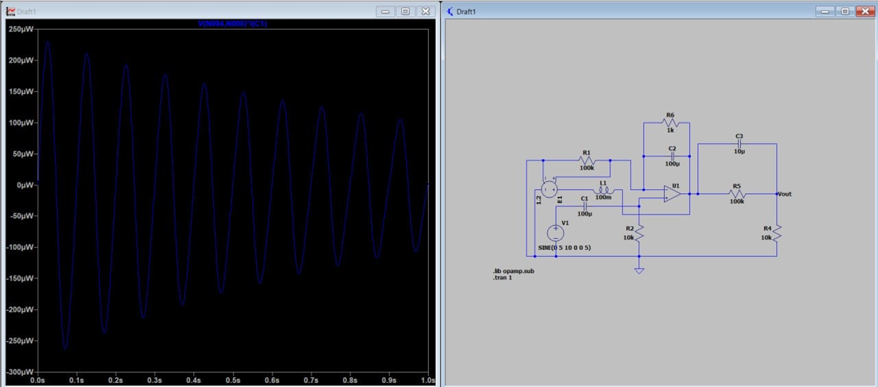

$$\frac{v_{out−v_{1}}}{R_{5}}+Jwc_{3}(v_{out−v_{1}})+\frac{v_{out}}{R_{4}}=0$$
$$v_{out}=\frac{\left(\frac{1}{R_{5}}+JwC_{3}\right)v_{1}}{\left(\frac{1}{R_{5}}+JwC_{3}+\frac{1}{R_{4}}\right)}$$

Slide 20
امپدانس و ادمیتانس دیده شده از دو سر منبع

Slide 21



$I_{T}$ = $\frac{v_{+}}{R_{2}}$ $\frac{{v_{+}}_{−} v_{T}}{\frac{1}{jωc_{1}}}$+ $I_{T}$ = 0
$v_{+}$ = $v_{T}$ - $\frac{I_{T}}{jωc_{1}}$
$v_{+}$
$\frac{v_{−}}{R_{1}}$ + $\frac{{v_{−} _ v}_{1}}{R_{6}}$ + $\frac{{v_{−} _ v}_{1}}{\frac{1}{jωc_{2}}}$ = 0
$v_{1}$ = $\frac{(\frac{1}{R_{1}} + \frac{1}{R_{6}} + jωc_{2})( v_{T} − \frac{I_{T}}{jωc_{1}}) }{(\frac{1}{R_{6}} + jωc_{2})}$
$v_{−}$

Slide 22


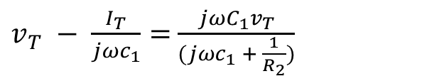
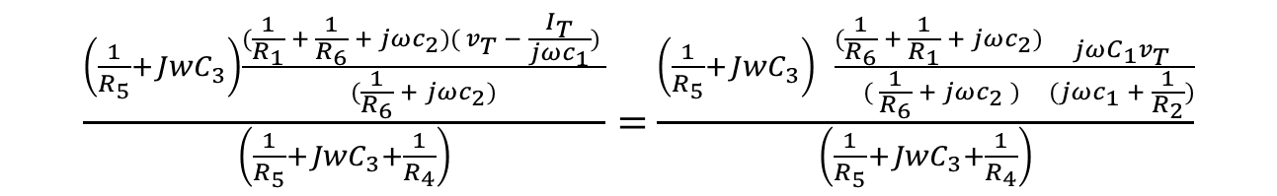
$$\frac{v_{out−v_{1}}}{R_{5}}+Jwc_{3}(v_{out−v_{1}})+\frac{v_{out}}{R_{4}}=0$$
$$v_{out}=\frac{\left(\frac{1}{R_{5}}+JwC_{3}\right)v_{1}}{\left(\frac{1}{R_{5}}+JwC_{3}+\frac{1}{R_{4}}\right)}$$
$\frac{\left(\frac{1}{R_{5}}+JwC_{3}\right)\frac{(\frac{1}{R_{1}} + \frac{1}{R_{6}} + jωc_{2})( v_{T} − \frac{I_{T}}{jωc_{1}}) }{(\frac{1}{R_{6}} + jωc_{2})}}{\left(\frac{1}{R_{5}}+JwC_{3}+\frac{1}{R_{4}}\right)}=$ $\frac{\left(\frac{1}{R_{5}}+JwC_{3}\right) \frac{(\frac{1}{R_{6}} + \frac{1}{R_{1}} + jωc_{2}) }{( \frac{1}{R_{6}} + jωc_{2} )}\frac{jωC_{1}v_{T}}{(jωc_{1} + \frac{1}{R_{2}})}}{\left(\frac{1}{R_{5}}+JwC_{3}+\frac{1}{R_{4}}\right)}$
$v_{T} − \frac{I_{T}}{jωc_{1}}=$ $\frac{jωC_{1}v_{T}}{(jωc_{1} + \frac{1}{R_{2}})}$
$$v_{T=\frac{I_{T}}{(1−JωC_{1})(JωC_{1})}+\frac{1}{(1−JωC_{1})(JωC_{1}+\frac{1}{R_{2}})}}$$

Slide 23
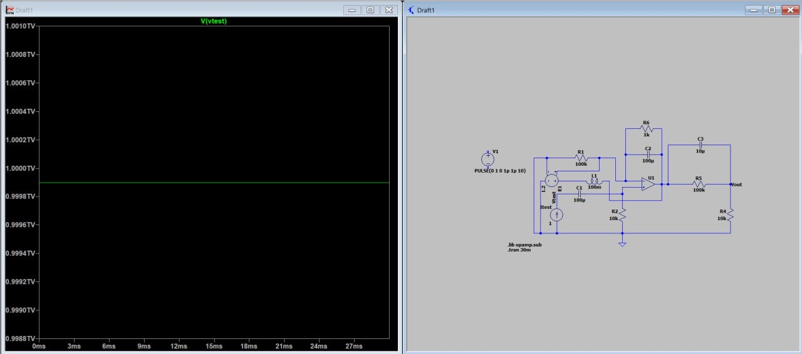

Slide 24


Slide 25
پایان

